Slide 1
Surrender & Sanctification
Mary Glenn Hadley & Marlene Smith
Deeper in the Spirit Workshop
March 17, 2018

Slide 2
Let's Get Acquainted
1. Give your name and where you are from
2. Say why you have chosen to participate in this series of workshops
3. What you hope to gain from these workshops

Slide 3
SURRENDER
But let the Lord Jesus Christ take control of you. Romans 13:14

Slide 4
“When we obey God,
we are sure that we know him.”
I John 2:3

Slide 5
Surrender Defined
Surrender means willingly giving our possessions, our bodies, our finances, our wills, our all and laying them before God, asking Him to take control of our lives.
“But let the Lord Jesus Christ take control of you…” Romans 13:14

Slide 6
When Does Surrender Begin?
When we first believe in Jesus and recognize sin in our lives, confess those sins and accept forgiveness through what Jesus Christ did for us on the cross

Slide 7
JESUS CALLS US TO A RADICAL RELATIONSHIP
“Whoever desires to come after Me, let him deny himself, and take up his cross, and follow Me. For whoever desires to save his life will lose it, but whoever loses his life for My sake and the gospel’s will save it.”
Mark 8:34-35

Slide 8
EXAMINE AREAS OF YOUR LIFE YOU MAINTAIN TIGHT CONTROL OVER
Money Our eating habits
Sex Our spending habits
Power How we spend our time
Our marriages Our relationships
Our morals Our habits
Our attitudes Our values
Our tongues Our hobbies

Slide 9
TWO BASIC FOUNDATIONS TO SURRENDING OUR LIVES TO GOD
1. How deep is your love for God?
2. Do we allow the teachings of God found in the Bible to guide our behavior, decisions and direction for our lives?

Slide 10
WHY SURRENDER YOUR LIFE TO GOD?
You will experience joy, fullness of life, forgiveness, peace, purpose for your life, and most of all you know you will spend eternity with God

Slide 11
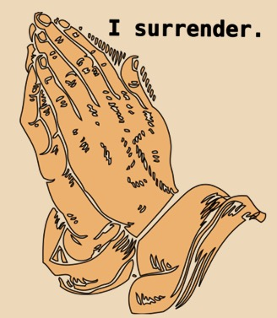
EXAMINE YOUR HEART
Money Eating habits
Sex Spending habits
Power How we spend our time
Marriages Relationships
Morals Habits
Attitudes Values
Our tongues Hobbies

Slide 12
Sanctification
S
A
N
C
T
I
F
Y

Slide 13
Sanctification
Surrender:
There can be no sanctification w/o surrender. Isaiah 6:1-7

Slide 14
Sanctification
Surrender
Admit:
We don't have a clue what God's definition of holiness (sanctification) is. Matt.7:7-8

Slide 15
Sanctification
Surrender
Admit
Nuts and bolts:
I Thessalonians. 4:3-8; I Pet. 1:15-16;
Rom. 6:11; II Tim. 2:14-26

Slide 16
Sanctification
Surrender
Admit
Nuts and bolts
Conforming to...
Where do we live? The kingdom of the world
or the kingdom of God?

Slide 17
Sanctification
Surrender
Admit
Nuts and bolts
Conforming to…
Transformation:
II Pet.1:3-11

Slide 18
Sanctification
Surrender
Admit
Nuts and bolts
Conforming to
Transformation
Indwelling Presence/Power:
Eph.3:14-21

Slide 19
Sanctification
Surrender
Admit
Nuts and Bolts
Conforming to…
Indwelling Presence/Power
Faith/Fruit
Heb.4:2; Is A. 26:3; Matt.5:16

Slide 20
Sanctification
Surrender
Admit
Nuts and bolts
Conforming to…
Transformation
Indwelling Presence/Power
Faith/Fruit
Yahweh and us:
I Cor.9:24-10:13; John 15:10-11

Slide 21
Sanctification
Surrender
Admit
Nuts and bolts
Conforming to
Transformation
Indwelling Presence/Power
Faith/Fruit
Yahweh and us

